Slide 1
CS F213
Object Oriented Programming
Lab 1
Introduction to Java

Slide 2
Lab structure
Key Concepts
Demo and Practise Problems
To be done during lab hours
Assignment Problems on JDoodle (Labs are evaluative)
Signup on JDoodle
Assignments to be submitted on Jdoodle within a week for this assignment.
Extra Practise Problems
To be done outside lab hours

Slide 3

Few important things
Be regular in labs and go through the reading materials.
Try all demo and practise problems.
Submit assignment problems in a timely manner on Jdoodle. No late submission requests will be catered to.
Use repository problems for extra practise.
Do not copy/paste code and any type of plagiarism is going to be strictly penalised.

Slide 4
To get started
Install JDK
Java Development Kit (JDK) is a software development environment used for developing Java applications and applets. It includes the
Java Runtime Environment (JRE)
Interpreter/loader (Java), a compiler (javac)
Archiver (jar)
Documentation generator (Javadoc) and other tools needed in Java development.
Install Eclipse
Eclipse is an integrated development environment used for Java programming.
No other IDE is allowed for lab sessions

Slide 5
First Java Program
Just remember
Every Java program has a class name which must match the filename, and
Every program must contain the main() method.
public class MyFirstJavaProgram {
/* This is my first java program.
* This will print 'Hello World' as the output
*/
public static void main(String []args) {
System.out.println("Hello World"); // prints Hello World
}
}

Slide 6
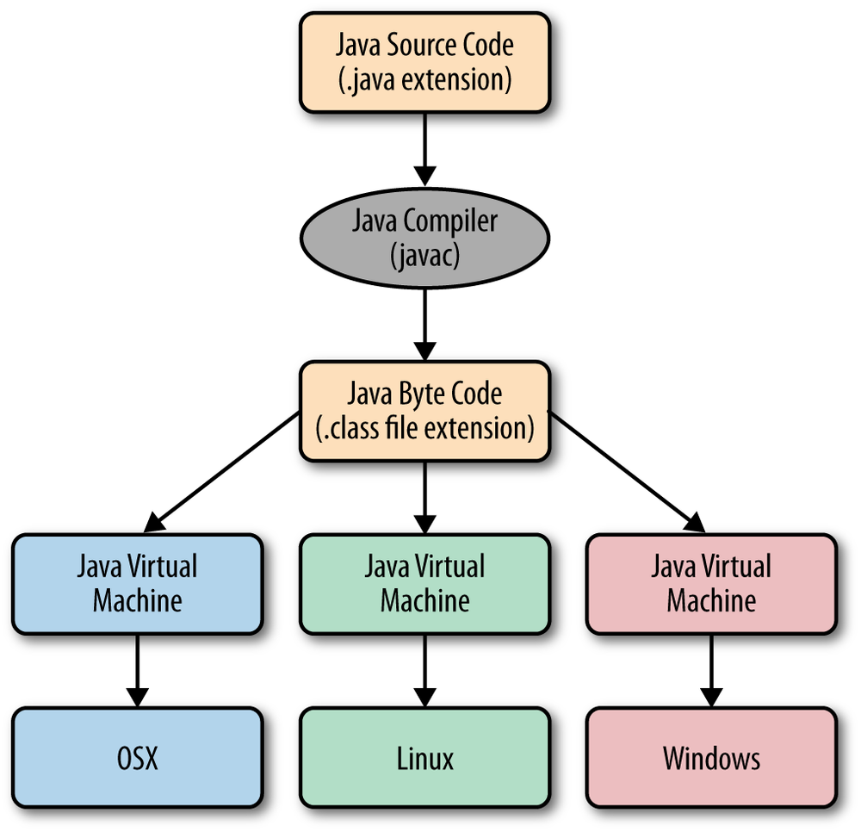
Compilation and Execution

Slide 7
Basic Syntax
About Java programs, it is very important to keep in mind the following points.
Case Sensitivity − Java is case sensitive, which means identifier Hello and hello would have different meaning in Java.
Class Names − For all class names the first letter should be in Upper Case. If several words are used to form a name of the class, each inner word's first letter should be in Upper Case. Example: class MyFirstJavaClass
Program File Name − Name of the program file should exactly match the class name.
Example: Assume 'MyFirstJavaProgram' is the class name. Then the file should be saved as 'MyFirstJavaProgram.java'
public static void main(String args[]) − Java program processing starts from the main() method which is a mandatory part of every Java program.

Slide 8
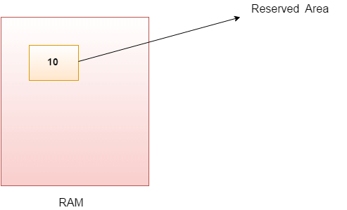
Variables
A variable is a container which holds the value while the Java program is executed.
int data=50;//Here data is variable

Slide 9
Data Types
Data types specify the different sizes and values that can be stored in the variable. In Java language, primitive data types are the building blocks of data manipulation.
There are 8 types of primitive data types:
boolean data type
byte data type
char data type
short data type
int data type
long data type
float data type
double data type

